Slide 1

VEGETATION CHANGE DETECTION THROUGH CLUSTERING OF LANDSAT-8 SATELLITE DATA OF PENCH NATIONAL PARK, INDIA USING GOOGLE EARTH ENGINE,R,K-MEAN CLUSTERING ALGORITHM, NDVI AND Q-GIS
WHERE MACHINE LEARNING MEETS GEOINMFORMATICS
Shuvam Sanyal- MSc(Semester II) in Data Science and Spatial Analytics, Symbiosis International(Deemed University),Pune,India
Divya Chandra:-MSc(Semester II) in Data Science and Spatial Analytics, Symbiosis International(Deemed University),Pune,India

Slide 2
OUTLINE
Area Description
Introduction
Research Topic
Research Methods
Research Findings
Suggestions

Slide 3
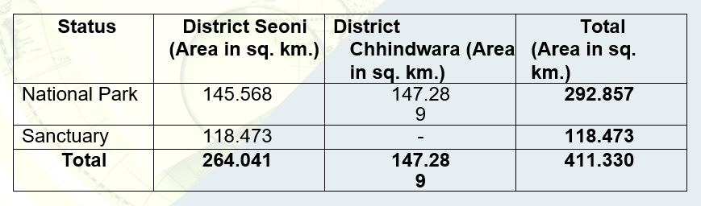
AREA DESCRIPTION
The Indira Priyadarshini Pinch National Park is located in Saone and Chinaware districts & The Pinch Mowgali Sanctuary is confined to Kurai block of Seoni district.. This area is located between longitudes 79⁰ 08' 51" to 79⁰ 31' 55" E and latitude21⁰ 38' 55" to 21⁰ 53' 52" N. The landsat 8 satellite data were acquired from USGS, dirtectly imported in Google Earth Engine and R, are used in this study.

Slide 4

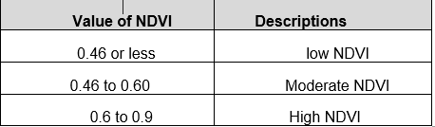
INTRODUCTION(NDVI)
Vegetation index can be used as an indicator to quantify the greenness of plants within satellite data. There are several vegetation indices, but the most frequently used index is the Normalized Difference Vegetation Index (NDVI).The Normalized Difference Vegetation Index (NDVI) is a numerical indicator that uses the visible and near-infrared bands of the electromagnetic spectrum, and is adopted to analyze remote sensing measurements and assess whether the target being observed contains live green vegetation or not. By analyzing images recorded from visible red and near-infrared (NIR) wavelengths, researchers can determine the coverage of vegetation on the surface of the Earth. NDVI can be expressed as (1):
Where RED and NIR stand for the spectral reflectance measurements acquired in the red (visible) and near-infrared regions, respectively.
NDVI has found a wide application in vegetative studies as it has been used to estimate crop yields, pasture performance, and rangeland carrying capacities among others.

Slide 5
INTRODUCTION( K-MEAN CLUSTERING)
K-means clustering is a clustering method that subdivides a single cluster or a collection of data points into K different clusters or groups.The algorithm analyzes the data to find organically similar data points and assigns each point to a cluster that consists of points with similar characteristics. Each cluster can then be used to label the data into different classes based on the characteristics of the data.K-Means clustering works by constantly trying to find a centroid with closely held data points. This means that each cluster will have a centroid and the data points in each cluster will be closer to its centroid compared to the other centroids.
For every object in our input imagery, k-means returns an index corresponding to a cluster. Label every pixel in the image with its cluster index. The cluster center output from k-means is determined. Using pixel labels, we separate objects in the satellite imagery by color. In unsupervised classification, we use the reflectance data, but we don’t supply any response data (that is, we do not identify any pixel as belonging to a particular class). This may seem odd, but it can be useful when we don’t have much prior knowledge of a study area. The algorithm groups pixels with similar spectral characteristics into groups.

Slide 6
RESEARCH TOPIC
Unsupervised Methods to detect change in Vegetation of Pench National Park Using K Means and NDVI Threshold
This study aims to detect change in vegetation in Landsat 8 satellite data for Pench National Park located in India using NDVI threshold and K mean unsupervised clustering for 2013 vs 2018.

Slide 7
RESEARCH METHOD
At first by writing python code on google earth engine, we defined the area of our interest(AOI) “Pench National Park”.
Then using the same platform, we got the landsat 8 satellite data and image of the same national park and calculated our NDVI and drawn a time series trend of how the vegetation got changed over the years from 2013 to 2018.
Then we applied k mean clustering unsupervised machine learning algorithm with the following steps:-

Slide 8

RESEARCH METHOD
Place K points into the space represented by the objects that are being clustered. These points represent initial group centroids.
Assign each object to the group that has the closest centroid.
When all objects have been assigned, recalculate the positions of the K centroids. Repeat steps 2 and 3 until the centroids no longer move. This produces a separation of the objects into groups from which the metric to be minimized can be calculated.
This algorithm aims at minimizing the objective function of a squared error function. The objective function is :-
Then we have put the satellite image in Q-GIS to produce the NDVI vegetation map of Pench National Park,Madhya-Pradesh,India.

Slide 9
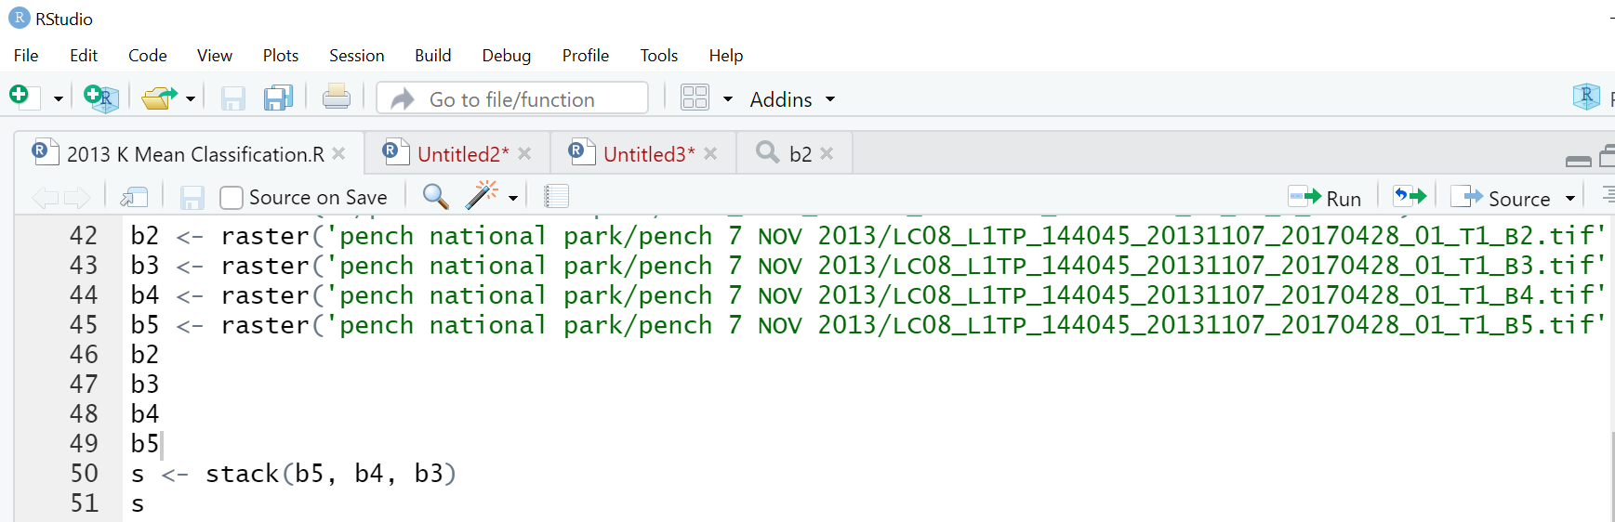
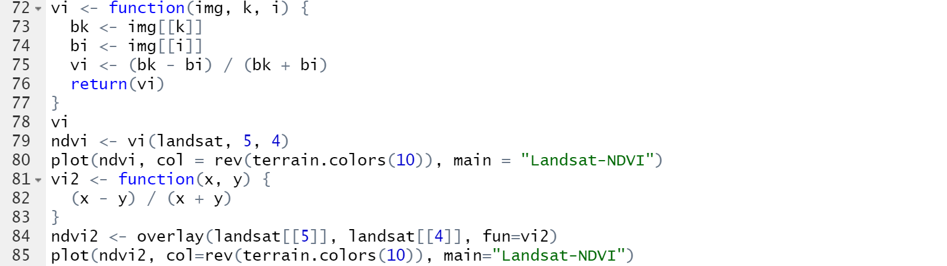
RESEARCH METHOD(R CODES)

Slide 10
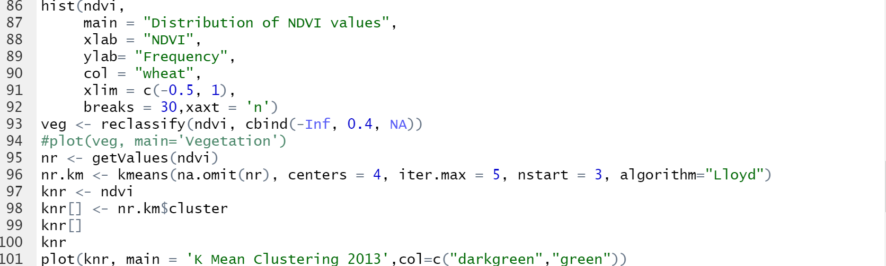
RESEARCH METHOD(R CODES)

Slide 11
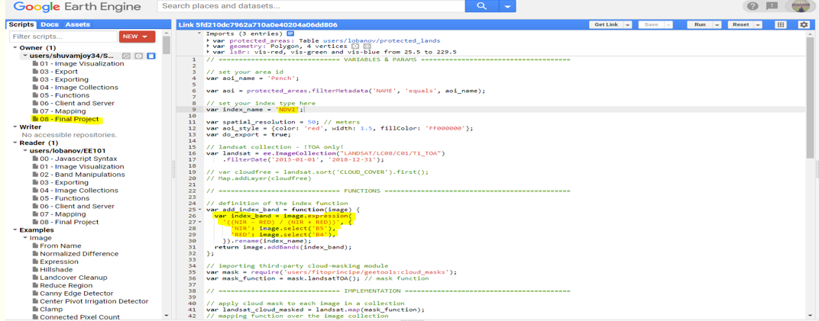
RESEARCH METHODS( GOOGLE EARTH ENGINE CODE)

Slide 12
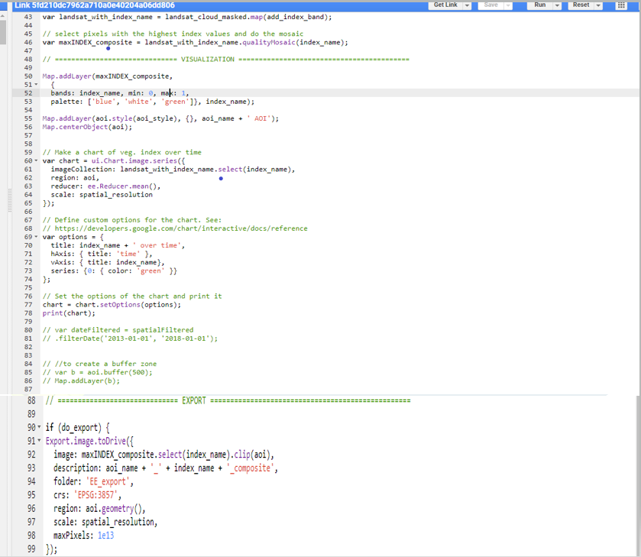
RESEARCH METHODS( GOOGLE EARTH ENGINE CODE)

Slide 13
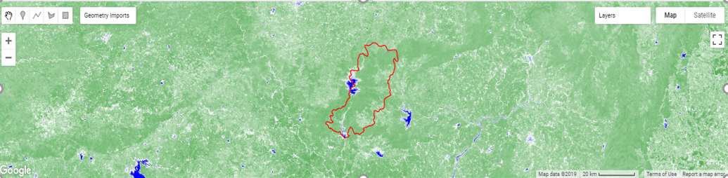
RESEARCH METHODS( GOOGLE EARTH ENGINE AOI)

Slide 14
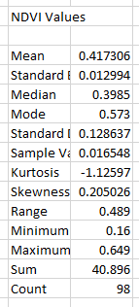
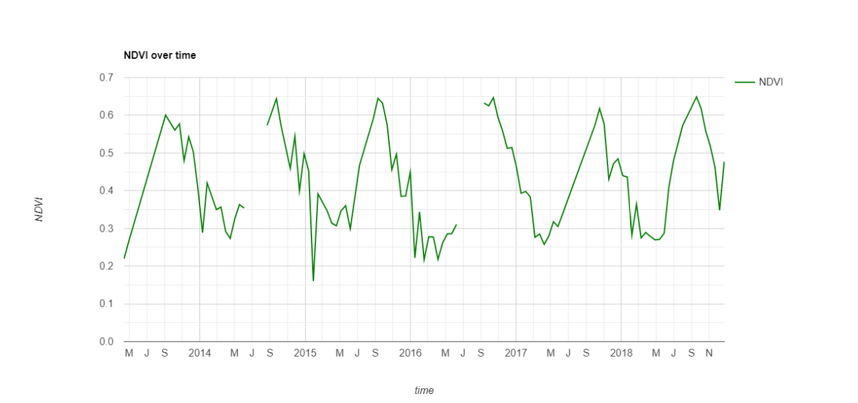
RESEARCH FINDINGS(NDVI)

Slide 15
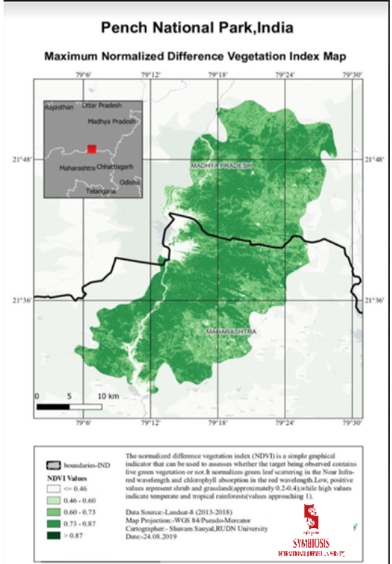
RESEARCH FINDINGS( QGIS NDVI MAP)

Slide 16
RESEARCH FINDINGS(NDVI)
From the above two pictures we can see that NDVI values do not cross 0.6 much with minimum NDVI being 0.16,average NDVI being 0.417,median NDVI being 0.3985 and highest NDVI being 0.649.
So overall we can conclude that on an average , we have medium level of vegetation in Pench National Park ,Madhya Pradesh, India with a trend of decreasing green vegetation quite frequently (NDVI Values less than 0.46 getting repeated the maximum times )seeing at the NDVI values table and the graph over time. This is not a good sign for any national park and some proper actions need to be taken to increase the level of green vegetation so that continuous decreasing trend of green vegentation can not affect the animals living peacefully as well as the overall well being of climate in the Pench National Park in negative ways.

Slide 17
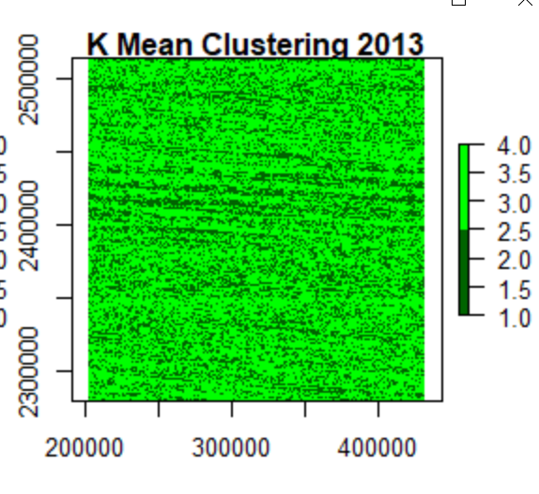
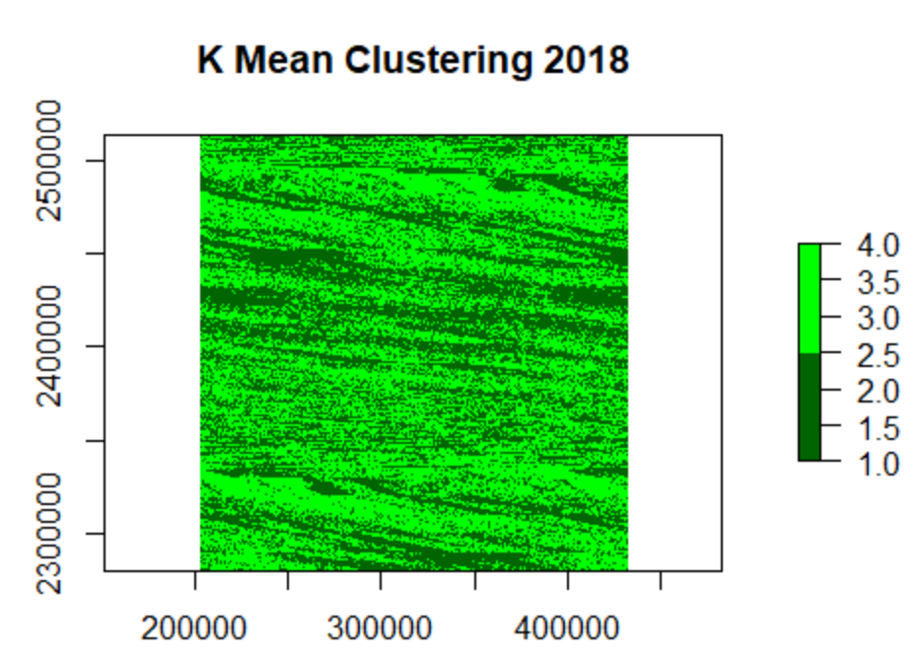
RESEARCH FINDINGS(K MEAN VEGETATION CLUSTERRING COMPARISON(2013 VS 2018)

Slide 18
RESEARCH FINDINGS(K MEAN VEGETATION CLUSTERTING)
The K mean clustering outcome comparison in previous slide is showing us that in 2013 there were mostly even distributions of vegetation pixel classes across the Pench National Park, but when we see the 2018 K mean clustering of the same satellite image of Pench National Park, we observe there are uneven distributions of vegetation pixels across the national park leading to the question of de forestation in particular areas.

Slide 19
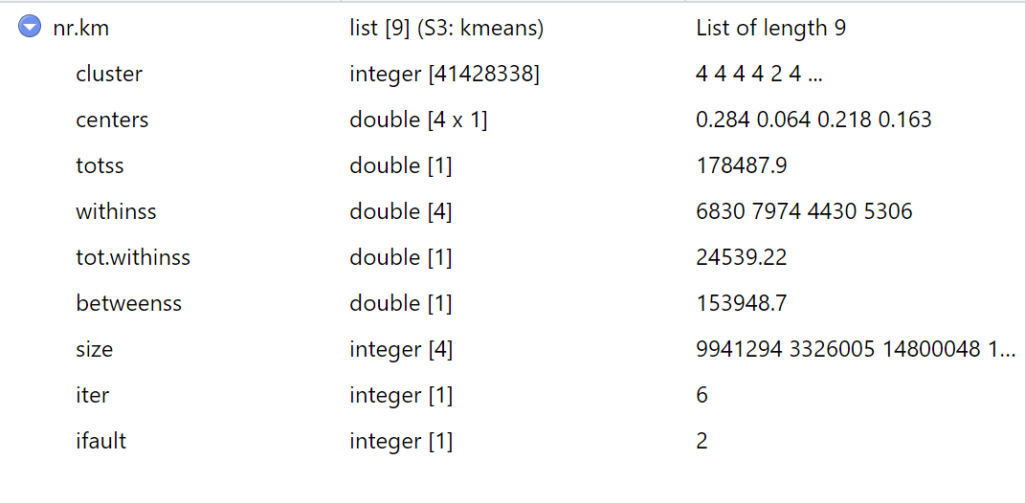
RESEARCH FINDINGS(K MEAN VEGETATION CLUSTERTING ACCURACY)
The R square value of our K mean classification came as around 0.62 for 2018. So our predicted classification of vegetation pixels for 2018 compared to 2013 are almost 62% correct compared to our ground truth output.

Slide 20
SUGGESTIONS
As we have seen there is a trend of low NDVI values and decreasing green vegetation area around the Pench National Park in India from 2013 to 2018, I have some recommendations on application of the workflow to solve similar vegetation problem in India as well as some suggestions below:-
Retain what is left and manage it properly.
Before starting restoration, address the factors that limit natural regeneration because these will also limit any planting.
Consider how large-scale plantings can increase linkages between native habitats, plus the total area of native habitat, and how they'll enhance all-year round food supplies for local fauna.
Eco-source an ecologically appropriate range of plant species and mycorrhizal fungi.

Slide 21
SUGGESSTIONS
Establish certification for seed and seedling supply.
Invest in new technologies for revegetation, especially for steep, inaccessible hill country.
Adopt best-practice planting and early management, including appropriate monitoring, to ensure the long-term success of restoration.
Integrate all areas of native vegetation – for example public, private, old growth, regenerating and planted – for an optimum result.

Slide 22
If you are working in Data Science and Predictive Statistical Modelling domain and have any valuable input for this ongoing project, you can share it via our email IDs:-
Shuvamjoy34@gmail.com
Divyachandra2007@gmail.com

Slide 23
Thank You

